Slide 1

PHP Syntax Overview
Abdulkarim Albanna
www.facebook/abdulkarimalbanna

Slide 2
Escaping to PHP
The PHP parsing engine needs a way to differentiate PHP code from other elements in the
page. The mechanism for doing so is known as 'escaping to PHP.
Notes:
A markup language is a set of tags and/or a set of rules for creating tags that can be embedded in digital text to provide additional information about the text in order to facilitate automated processing of it, including editing and formatting for display or printing.Dec 13, 2006
The browsers we will talk about
There are five major browsers used on desktop today: Chrome, Internet Explorer, Firefox, Safari and Opera. On mobile, the main browsers are Android Browser, iPhone, Opera Mini and Opera Mobile, UC Browser, the Nokia S40/S60 browsers and Chrome–all of which, except for the Opera browsers, are based on WebKit. I will give examples from the open source browsers Firefox and Chrome, and Safari (which is partly open source). According to StatCounter statistics (as of June 2013) Chrome, Firefox and Safari make up around 71% of global desktop browser usage. On mobile, Android Browser, iPhone and Chrome constitute around 54% of usage.
The browser's main functionality
The main function of a browser is to present the web resource you choose, by requesting it from the server and displaying it in the browser window. The resource is usually an HTML document, but may also be a PDF, image, or some other type of content. The location of the resource is specified by the user using a URI (Uniform Resource Identifier).
The way the browser interprets and displays HTML files is specified in the HTML and CSS specifications. These specifications are maintained by the W3C (World Wide Web Consortium) organization, which is the standards organization for the web. For years browsers conformed to only a part of the specifications and developed their own extensions. That caused serious compatibility issues for web authors. Today most of the browsers more or less conform to the specifications.

Slide 3
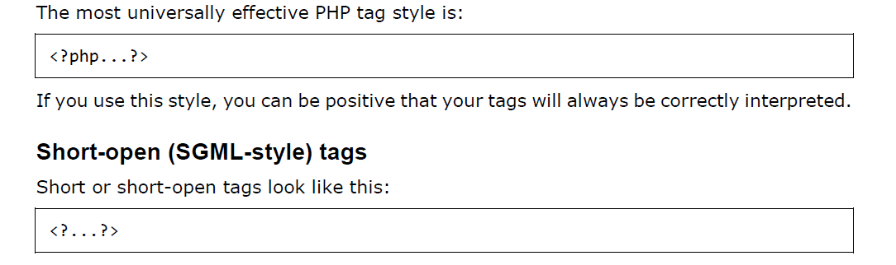
Canonical PHP tags
Notes:
A markup language is a set of tags and/or a set of rules for creating tags that can be embedded in digital text to provide additional information about the text in order to facilitate automated processing of it, including editing and formatting for display or printing.Dec 13, 2006
The browsers we will talk about
There are five major browsers used on desktop today: Chrome, Internet Explorer, Firefox, Safari and Opera. On mobile, the main browsers are Android Browser, iPhone, Opera Mini and Opera Mobile, UC Browser, the Nokia S40/S60 browsers and Chrome–all of which, except for the Opera browsers, are based on WebKit. I will give examples from the open source browsers Firefox and Chrome, and Safari (which is partly open source). According to StatCounter statistics (as of June 2013) Chrome, Firefox and Safari make up around 71% of global desktop browser usage. On mobile, Android Browser, iPhone and Chrome constitute around 54% of usage.
The browser's main functionality
The main function of a browser is to present the web resource you choose, by requesting it from the server and displaying it in the browser window. The resource is usually an HTML document, but may also be a PDF, image, or some other type of content. The location of the resource is specified by the user using a URI (Uniform Resource Identifier).
The way the browser interprets and displays HTML files is specified in the HTML and CSS specifications. These specifications are maintained by the W3C (World Wide Web Consortium) organization, which is the standards organization for the web. For years browsers conformed to only a part of the specifications and developed their own extensions. That caused serious compatibility issues for web authors. Today most of the browsers more or less conform to the specifications.

Slide 4
Commenting PHP Code
Single-line comments:
<?
# This is a comment, and
# This is the second line of the comment
// This is a comment too. Each style comments only
print "An example with single line comments";
?>
Notes:
A markup language is a set of tags and/or a set of rules for creating tags that can be embedded in digital text to provide additional information about the text in order to facilitate automated processing of it, including editing and formatting for display or printing.Dec 13, 2006
The browsers we will talk about
There are five major browsers used on desktop today: Chrome, Internet Explorer, Firefox, Safari and Opera. On mobile, the main browsers are Android Browser, iPhone, Opera Mini and Opera Mobile, UC Browser, the Nokia S40/S60 browsers and Chrome–all of which, except for the Opera browsers, are based on WebKit. I will give examples from the open source browsers Firefox and Chrome, and Safari (which is partly open source). According to StatCounter statistics (as of June 2013) Chrome, Firefox and Safari make up around 71% of global desktop browser usage. On mobile, Android Browser, iPhone and Chrome constitute around 54% of usage.
The browser's main functionality
The main function of a browser is to present the web resource you choose, by requesting it from the server and displaying it in the browser window. The resource is usually an HTML document, but may also be a PDF, image, or some other type of content. The location of the resource is specified by the user using a URI (Uniform Resource Identifier).
The way the browser interprets and displays HTML files is specified in the HTML and CSS specifications. These specifications are maintained by the W3C (World Wide Web Consortium) organization, which is the standards organization for the web. For years browsers conformed to only a part of the specifications and developed their own extensions. That caused serious compatibility issues for web authors. Today most of the browsers more or less conform to the specifications.

Slide 5
Commenting PHP Code
Multi-lines comments:
<?
/* This is a comment with multiline
*/
print "An example with multi line comments";
?>
Notes:
A markup language is a set of tags and/or a set of rules for creating tags that can be embedded in digital text to provide additional information about the text in order to facilitate automated processing of it, including editing and formatting for display or printing.Dec 13, 2006
The browsers we will talk about
There are five major browsers used on desktop today: Chrome, Internet Explorer, Firefox, Safari and Opera. On mobile, the main browsers are Android Browser, iPhone, Opera Mini and Opera Mobile, UC Browser, the Nokia S40/S60 browsers and Chrome–all of which, except for the Opera browsers, are based on WebKit. I will give examples from the open source browsers Firefox and Chrome, and Safari (which is partly open source). According to StatCounter statistics (as of June 2013) Chrome, Firefox and Safari make up around 71% of global desktop browser usage. On mobile, Android Browser, iPhone and Chrome constitute around 54% of usage.
The browser's main functionality
The main function of a browser is to present the web resource you choose, by requesting it from the server and displaying it in the browser window. The resource is usually an HTML document, but may also be a PDF, image, or some other type of content. The location of the resource is specified by the user using a URI (Uniform Resource Identifier).
The way the browser interprets and displays HTML files is specified in the HTML and CSS specifications. These specifications are maintained by the W3C (World Wide Web Consortium) organization, which is the standards organization for the web. For years browsers conformed to only a part of the specifications and developed their own extensions. That caused serious compatibility issues for web authors. Today most of the browsers more or less conform to the specifications.

Slide 6
PHP is whitespace insensitive
$four = 2 + 2; // single spaces
$four <tab>=<tab2<tab>+<tab>2 ; // spaces and tabs
$four =
2+
2; // multiple lines
Notes:
A markup language is a set of tags and/or a set of rules for creating tags that can be embedded in digital text to provide additional information about the text in order to facilitate automated processing of it, including editing and formatting for display or printing.Dec 13, 2006
The browsers we will talk about
There are five major browsers used on desktop today: Chrome, Internet Explorer, Firefox, Safari and Opera. On mobile, the main browsers are Android Browser, iPhone, Opera Mini and Opera Mobile, UC Browser, the Nokia S40/S60 browsers and Chrome–all of which, except for the Opera browsers, are based on WebKit. I will give examples from the open source browsers Firefox and Chrome, and Safari (which is partly open source). According to StatCounter statistics (as of June 2013) Chrome, Firefox and Safari make up around 71% of global desktop browser usage. On mobile, Android Browser, iPhone and Chrome constitute around 54% of usage.
The browser's main functionality
The main function of a browser is to present the web resource you choose, by requesting it from the server and displaying it in the browser window. The resource is usually an HTML document, but may also be a PDF, image, or some other type of content. The location of the resource is specified by the user using a URI (Uniform Resource Identifier).
The way the browser interprets and displays HTML files is specified in the HTML and CSS specifications. These specifications are maintained by the W3C (World Wide Web Consortium) organization, which is the standards organization for the web. For years browsers conformed to only a part of the specifications and developed their own extensions. That caused serious compatibility issues for web authors. Today most of the browsers more or less conform to the specifications.

Slide 7
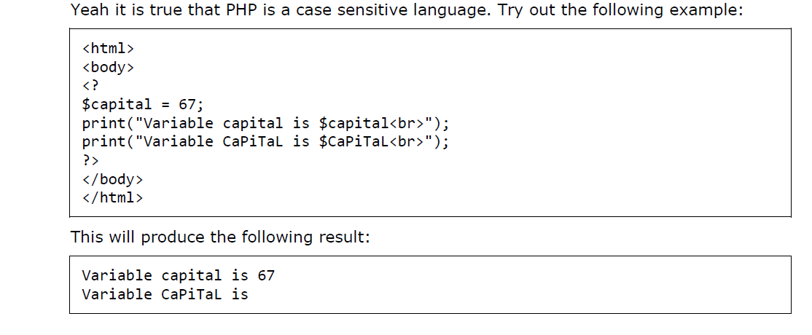
Statements are expressions terminated by semicolons
Notes:
A markup language is a set of tags and/or a set of rules for creating tags that can be embedded in digital text to provide additional information about the text in order to facilitate automated processing of it, including editing and formatting for display or printing.Dec 13, 2006
The browsers we will talk about
There are five major browsers used on desktop today: Chrome, Internet Explorer, Firefox, Safari and Opera. On mobile, the main browsers are Android Browser, iPhone, Opera Mini and Opera Mobile, UC Browser, the Nokia S40/S60 browsers and Chrome–all of which, except for the Opera browsers, are based on WebKit. I will give examples from the open source browsers Firefox and Chrome, and Safari (which is partly open source). According to StatCounter statistics (as of June 2013) Chrome, Firefox and Safari make up around 71% of global desktop browser usage. On mobile, Android Browser, iPhone and Chrome constitute around 54% of usage.
The browser's main functionality
The main function of a browser is to present the web resource you choose, by requesting it from the server and displaying it in the browser window. The resource is usually an HTML document, but may also be a PDF, image, or some other type of content. The location of the resource is specified by the user using a URI (Uniform Resource Identifier).
The way the browser interprets and displays HTML files is specified in the HTML and CSS specifications. These specifications are maintained by the W3C (World Wide Web Consortium) organization, which is the standards organization for the web. For years browsers conformed to only a part of the specifications and developed their own extensions. That caused serious compatibility issues for web authors. Today most of the browsers more or less conform to the specifications.

Slide 8
PHP is case sensitive
Notes:
A markup language is a set of tags and/or a set of rules for creating tags that can be embedded in digital text to provide additional information about the text in order to facilitate automated processing of it, including editing and formatting for display or printing.Dec 13, 2006
The browsers we will talk about
There are five major browsers used on desktop today: Chrome, Internet Explorer, Firefox, Safari and Opera. On mobile, the main browsers are Android Browser, iPhone, Opera Mini and Opera Mobile, UC Browser, the Nokia S40/S60 browsers and Chrome–all of which, except for the Opera browsers, are based on WebKit. I will give examples from the open source browsers Firefox and Chrome, and Safari (which is partly open source). According to StatCounter statistics (as of June 2013) Chrome, Firefox and Safari make up around 71% of global desktop browser usage. On mobile, Android Browser, iPhone and Chrome constitute around 54% of usage.
The browser's main functionality
The main function of a browser is to present the web resource you choose, by requesting it from the server and displaying it in the browser window. The resource is usually an HTML document, but may also be a PDF, image, or some other type of content. The location of the resource is specified by the user using a URI (Uniform Resource Identifier).
The way the browser interprets and displays HTML files is specified in the HTML and CSS specifications. These specifications are maintained by the W3C (World Wide Web Consortium) organization, which is the standards organization for the web. For years browsers conformed to only a part of the specifications and developed their own extensions. That caused serious compatibility issues for web authors. Today most of the browsers more or less conform to the specifications.

Slide 9
PHP ─ Variable Types
PHP has a total of eight data types which we use to construct our variables:
• Integers: are whole numbers, without a decimal point, like 4195.
• Doubles: are floating-point numbers, like 3.14159 or 49.1.
• Booleans: have only two possible values either true or false.
• NULL: is a special type that only has one value: NULL.
• Strings: are sequences of characters, like 'PHP supports string operations.'
• Arrays: are named and indexed collections of other values.
• Objects: are instances of programmer-defined classes, which can package up both
other kinds of values and functions that are specific to the class.
• Resources: are special variables that hold references to resources external to PHP
(such as database connections).
Notes:
A markup language is a set of tags and/or a set of rules for creating tags that can be embedded in digital text to provide additional information about the text in order to facilitate automated processing of it, including editing and formatting for display or printing.Dec 13, 2006
The browsers we will talk about
There are five major browsers used on desktop today: Chrome, Internet Explorer, Firefox, Safari and Opera. On mobile, the main browsers are Android Browser, iPhone, Opera Mini and Opera Mobile, UC Browser, the Nokia S40/S60 browsers and Chrome–all of which, except for the Opera browsers, are based on WebKit. I will give examples from the open source browsers Firefox and Chrome, and Safari (which is partly open source). According to StatCounter statistics (as of June 2013) Chrome, Firefox and Safari make up around 71% of global desktop browser usage. On mobile, Android Browser, iPhone and Chrome constitute around 54% of usage.
The browser's main functionality
The main function of a browser is to present the web resource you choose, by requesting it from the server and displaying it in the browser window. The resource is usually an HTML document, but may also be a PDF, image, or some other type of content. The location of the resource is specified by the user using a URI (Uniform Resource Identifier).
The way the browser interprets and displays HTML files is specified in the HTML and CSS specifications. These specifications are maintained by the W3C (World Wide Web Consortium) organization, which is the standards organization for the web. For years browsers conformed to only a part of the specifications and developed their own extensions. That caused serious compatibility issues for web authors. Today most of the browsers more or less conform to the specifications.

Slide 10
Variable Naming
Rules for naming a variable is:
• Variable names must begin with a letter or underscore character.
• A variable name can consist of numbers, letters, underscores but you cannot use
characters like + , - , % , ( , ) . & , etc
There is no size limit for variables.
Notes:
A markup language is a set of tags and/or a set of rules for creating tags that can be embedded in digital text to provide additional information about the text in order to facilitate automated processing of it, including editing and formatting for display or printing.Dec 13, 2006
The browsers we will talk about
There are five major browsers used on desktop today: Chrome, Internet Explorer, Firefox, Safari and Opera. On mobile, the main browsers are Android Browser, iPhone, Opera Mini and Opera Mobile, UC Browser, the Nokia S40/S60 browsers and Chrome–all of which, except for the Opera browsers, are based on WebKit. I will give examples from the open source browsers Firefox and Chrome, and Safari (which is partly open source). According to StatCounter statistics (as of June 2013) Chrome, Firefox and Safari make up around 71% of global desktop browser usage. On mobile, Android Browser, iPhone and Chrome constitute around 54% of usage.
The browser's main functionality
The main function of a browser is to present the web resource you choose, by requesting it from the server and displaying it in the browser window. The resource is usually an HTML document, but may also be a PDF, image, or some other type of content. The location of the resource is specified by the user using a URI (Uniform Resource Identifier).
The way the browser interprets and displays HTML files is specified in the HTML and CSS specifications. These specifications are maintained by the W3C (World Wide Web Consortium) organization, which is the standards organization for the web. For years browsers conformed to only a part of the specifications and developed their own extensions. That caused serious compatibility issues for web authors. Today most of the browsers more or less conform to the specifications.

Slide 11
PHP – Variables
Scope can be defined as the range of availability a variable has to the program in which it
is declared. PHP variables can be one of four scope types:
Local variables
Function parameters
Global variables
Static variables
Notes:
A markup language is a set of tags and/or a set of rules for creating tags that can be embedded in digital text to provide additional information about the text in order to facilitate automated processing of it, including editing and formatting for display or printing.Dec 13, 2006
The browsers we will talk about
There are five major browsers used on desktop today: Chrome, Internet Explorer, Firefox, Safari and Opera. On mobile, the main browsers are Android Browser, iPhone, Opera Mini and Opera Mobile, UC Browser, the Nokia S40/S60 browsers and Chrome–all of which, except for the Opera browsers, are based on WebKit. I will give examples from the open source browsers Firefox and Chrome, and Safari (which is partly open source). According to StatCounter statistics (as of June 2013) Chrome, Firefox and Safari make up around 71% of global desktop browser usage. On mobile, Android Browser, iPhone and Chrome constitute around 54% of usage.
The browser's main functionality
The main function of a browser is to present the web resource you choose, by requesting it from the server and displaying it in the browser window. The resource is usually an HTML document, but may also be a PDF, image, or some other type of content. The location of the resource is specified by the user using a URI (Uniform Resource Identifier).
The way the browser interprets and displays HTML files is specified in the HTML and CSS specifications. These specifications are maintained by the W3C (World Wide Web Consortium) organization, which is the standards organization for the web. For years browsers conformed to only a part of the specifications and developed their own extensions. That caused serious compatibility issues for web authors. Today most of the browsers more or less conform to the specifications.

Slide 12
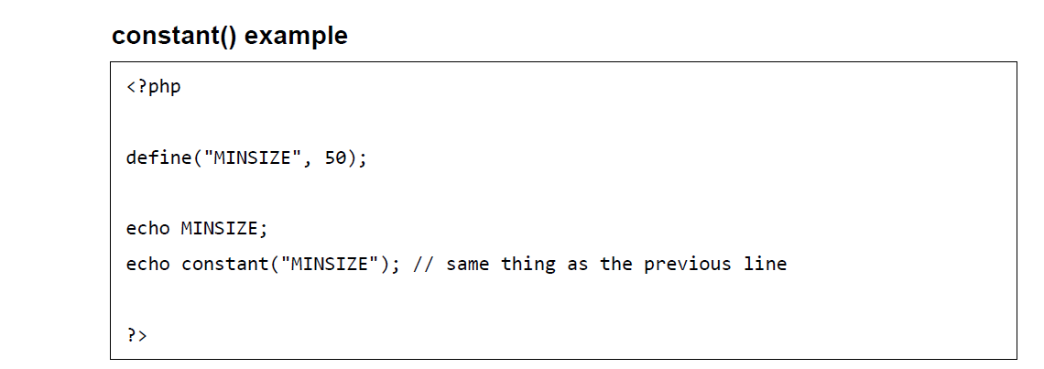
PHP ─ Constants
Notes:
A markup language is a set of tags and/or a set of rules for creating tags that can be embedded in digital text to provide additional information about the text in order to facilitate automated processing of it, including editing and formatting for display or printing.Dec 13, 2006
The browsers we will talk about
There are five major browsers used on desktop today: Chrome, Internet Explorer, Firefox, Safari and Opera. On mobile, the main browsers are Android Browser, iPhone, Opera Mini and Opera Mobile, UC Browser, the Nokia S40/S60 browsers and Chrome–all of which, except for the Opera browsers, are based on WebKit. I will give examples from the open source browsers Firefox and Chrome, and Safari (which is partly open source). According to StatCounter statistics (as of June 2013) Chrome, Firefox and Safari make up around 71% of global desktop browser usage. On mobile, Android Browser, iPhone and Chrome constitute around 54% of usage.
The browser's main functionality
The main function of a browser is to present the web resource you choose, by requesting it from the server and displaying it in the browser window. The resource is usually an HTML document, but may also be a PDF, image, or some other type of content. The location of the resource is specified by the user using a URI (Uniform Resource Identifier).
The way the browser interprets and displays HTML files is specified in the HTML and CSS specifications. These specifications are maintained by the W3C (World Wide Web Consortium) organization, which is the standards organization for the web. For years browsers conformed to only a part of the specifications and developed their own extensions. That caused serious compatibility issues for web authors. Today most of the browsers more or less conform to the specifications.

Slide 13
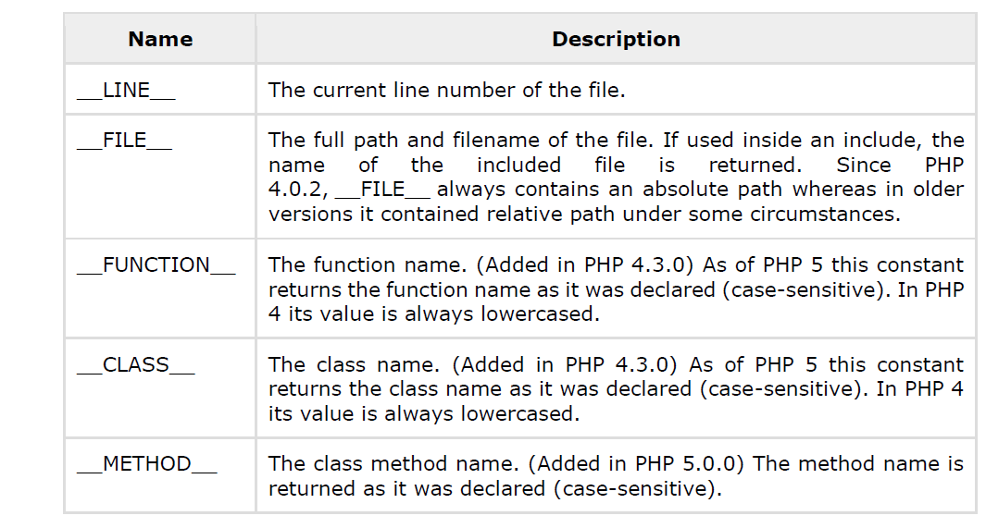
PHP Magic constants
PHP provides a large number of predefined constants to any script which it runs.
Notes:
A markup language is a set of tags and/or a set of rules for creating tags that can be embedded in digital text to provide additional information about the text in order to facilitate automated processing of it, including editing and formatting for display or printing.Dec 13, 2006
The browsers we will talk about
There are five major browsers used on desktop today: Chrome, Internet Explorer, Firefox, Safari and Opera. On mobile, the main browsers are Android Browser, iPhone, Opera Mini and Opera Mobile, UC Browser, the Nokia S40/S60 browsers and Chrome–all of which, except for the Opera browsers, are based on WebKit. I will give examples from the open source browsers Firefox and Chrome, and Safari (which is partly open source). According to StatCounter statistics (as of June 2013) Chrome, Firefox and Safari make up around 71% of global desktop browser usage. On mobile, Android Browser, iPhone and Chrome constitute around 54% of usage.
The browser's main functionality
The main function of a browser is to present the web resource you choose, by requesting it from the server and displaying it in the browser window. The resource is usually an HTML document, but may also be a PDF, image, or some other type of content. The location of the resource is specified by the user using a URI (Uniform Resource Identifier).
The way the browser interprets and displays HTML files is specified in the HTML and CSS specifications. These specifications are maintained by the W3C (World Wide Web Consortium) organization, which is the standards organization for the web. For years browsers conformed to only a part of the specifications and developed their own extensions. That caused serious compatibility issues for web authors. Today most of the browsers more or less conform to the specifications.

Slide 14
PHP ─ Operator Types
Arithmetic Operators
Comparison Operators
Logical (or Relational) Operators
Assignment Operators
Conditional (or ternary) Operators
Notes:
A markup language is a set of tags and/or a set of rules for creating tags that can be embedded in digital text to provide additional information about the text in order to facilitate automated processing of it, including editing and formatting for display or printing.Dec 13, 2006
The browsers we will talk about
There are five major browsers used on desktop today: Chrome, Internet Explorer, Firefox, Safari and Opera. On mobile, the main browsers are Android Browser, iPhone, Opera Mini and Opera Mobile, UC Browser, the Nokia S40/S60 browsers and Chrome–all of which, except for the Opera browsers, are based on WebKit. I will give examples from the open source browsers Firefox and Chrome, and Safari (which is partly open source). According to StatCounter statistics (as of June 2013) Chrome, Firefox and Safari make up around 71% of global desktop browser usage. On mobile, Android Browser, iPhone and Chrome constitute around 54% of usage.
The browser's main functionality
The main function of a browser is to present the web resource you choose, by requesting it from the server and displaying it in the browser window. The resource is usually an HTML document, but may also be a PDF, image, or some other type of content. The location of the resource is specified by the user using a URI (Uniform Resource Identifier).
The way the browser interprets and displays HTML files is specified in the HTML and CSS specifications. These specifications are maintained by the W3C (World Wide Web Consortium) organization, which is the standards organization for the web. For years browsers conformed to only a part of the specifications and developed their own extensions. That caused serious compatibility issues for web authors. Today most of the browsers more or less conform to the specifications.

Slide 15
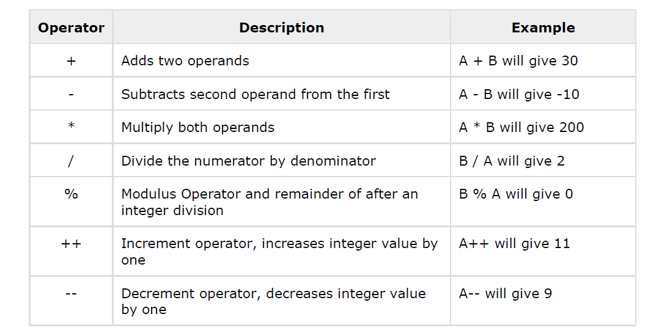
PHP ─ Operator Types
Arithmetic Operators
Notes:
A markup language is a set of tags and/or a set of rules for creating tags that can be embedded in digital text to provide additional information about the text in order to facilitate automated processing of it, including editing and formatting for display or printing.Dec 13, 2006
The browsers we will talk about
There are five major browsers used on desktop today: Chrome, Internet Explorer, Firefox, Safari and Opera. On mobile, the main browsers are Android Browser, iPhone, Opera Mini and Opera Mobile, UC Browser, the Nokia S40/S60 browsers and Chrome–all of which, except for the Opera browsers, are based on WebKit. I will give examples from the open source browsers Firefox and Chrome, and Safari (which is partly open source). According to StatCounter statistics (as of June 2013) Chrome, Firefox and Safari make up around 71% of global desktop browser usage. On mobile, Android Browser, iPhone and Chrome constitute around 54% of usage.
The browser's main functionality
The main function of a browser is to present the web resource you choose, by requesting it from the server and displaying it in the browser window. The resource is usually an HTML document, but may also be a PDF, image, or some other type of content. The location of the resource is specified by the user using a URI (Uniform Resource Identifier).
The way the browser interprets and displays HTML files is specified in the HTML and CSS specifications. These specifications are maintained by the W3C (World Wide Web Consortium) organization, which is the standards organization for the web. For years browsers conformed to only a part of the specifications and developed their own extensions. That caused serious compatibility issues for web authors. Today most of the browsers more or less conform to the specifications.

Slide 16
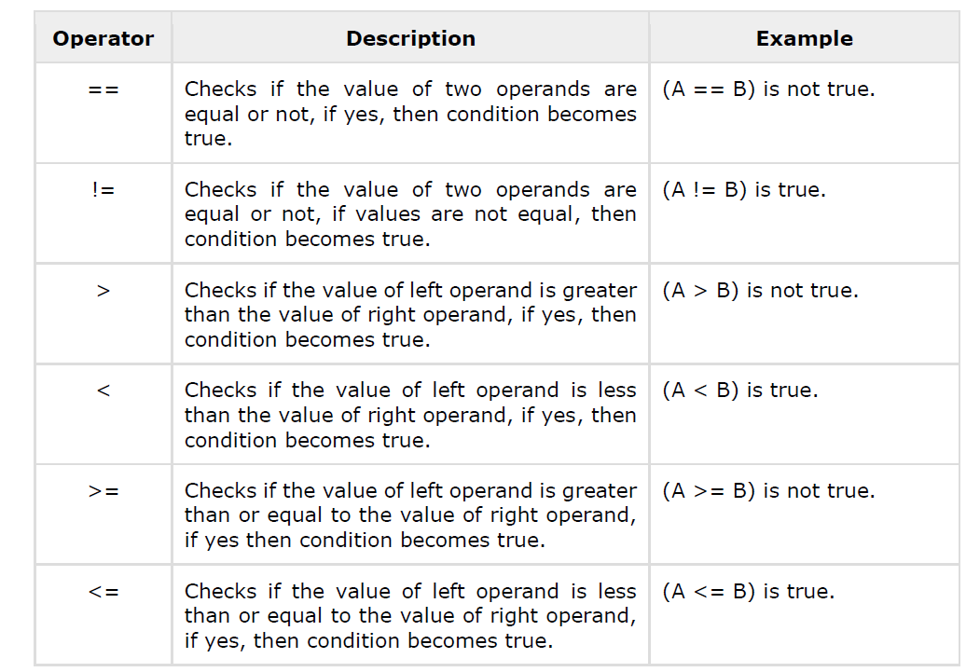
PHP ─ Operator Types
Comparison Operators
Notes:
A markup language is a set of tags and/or a set of rules for creating tags that can be embedded in digital text to provide additional information about the text in order to facilitate automated processing of it, including editing and formatting for display or printing.Dec 13, 2006
The browsers we will talk about
There are five major browsers used on desktop today: Chrome, Internet Explorer, Firefox, Safari and Opera. On mobile, the main browsers are Android Browser, iPhone, Opera Mini and Opera Mobile, UC Browser, the Nokia S40/S60 browsers and Chrome–all of which, except for the Opera browsers, are based on WebKit. I will give examples from the open source browsers Firefox and Chrome, and Safari (which is partly open source). According to StatCounter statistics (as of June 2013) Chrome, Firefox and Safari make up around 71% of global desktop browser usage. On mobile, Android Browser, iPhone and Chrome constitute around 54% of usage.
The browser's main functionality
The main function of a browser is to present the web resource you choose, by requesting it from the server and displaying it in the browser window. The resource is usually an HTML document, but may also be a PDF, image, or some other type of content. The location of the resource is specified by the user using a URI (Uniform Resource Identifier).
The way the browser interprets and displays HTML files is specified in the HTML and CSS specifications. These specifications are maintained by the W3C (World Wide Web Consortium) organization, which is the standards organization for the web. For years browsers conformed to only a part of the specifications and developed their own extensions. That caused serious compatibility issues for web authors. Today most of the browsers more or less conform to the specifications.

Slide 17
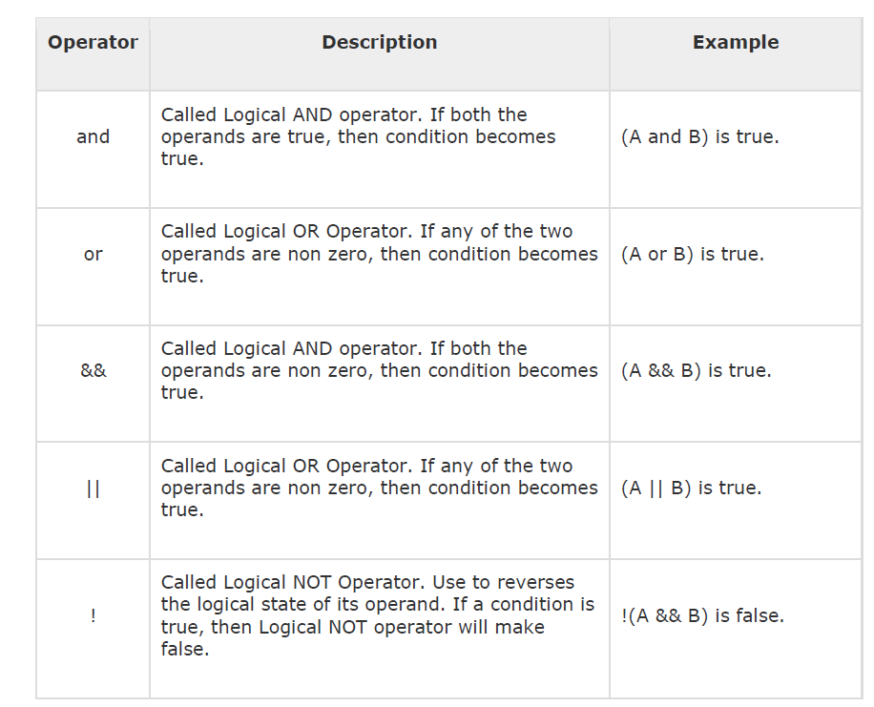
PHP ─ Operator Types
Logical Operators
Notes:
A markup language is a set of tags and/or a set of rules for creating tags that can be embedded in digital text to provide additional information about the text in order to facilitate automated processing of it, including editing and formatting for display or printing.Dec 13, 2006
The browsers we will talk about
There are five major browsers used on desktop today: Chrome, Internet Explorer, Firefox, Safari and Opera. On mobile, the main browsers are Android Browser, iPhone, Opera Mini and Opera Mobile, UC Browser, the Nokia S40/S60 browsers and Chrome–all of which, except for the Opera browsers, are based on WebKit. I will give examples from the open source browsers Firefox and Chrome, and Safari (which is partly open source). According to StatCounter statistics (as of June 2013) Chrome, Firefox and Safari make up around 71% of global desktop browser usage. On mobile, Android Browser, iPhone and Chrome constitute around 54% of usage.
The browser's main functionality
The main function of a browser is to present the web resource you choose, by requesting it from the server and displaying it in the browser window. The resource is usually an HTML document, but may also be a PDF, image, or some other type of content. The location of the resource is specified by the user using a URI (Uniform Resource Identifier).
The way the browser interprets and displays HTML files is specified in the HTML and CSS specifications. These specifications are maintained by the W3C (World Wide Web Consortium) organization, which is the standards organization for the web. For years browsers conformed to only a part of the specifications and developed their own extensions. That caused serious compatibility issues for web authors. Today most of the browsers more or less conform to the specifications.

Slide 18
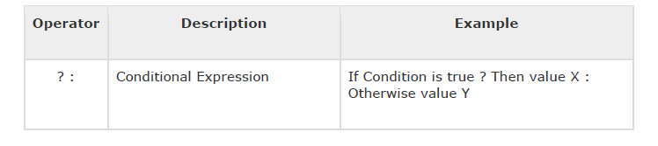
PHP ─ Operator Types
Conditional Operator
Notes:
A markup language is a set of tags and/or a set of rules for creating tags that can be embedded in digital text to provide additional information about the text in order to facilitate automated processing of it, including editing and formatting for display or printing.Dec 13, 2006
The browsers we will talk about
There are five major browsers used on desktop today: Chrome, Internet Explorer, Firefox, Safari and Opera. On mobile, the main browsers are Android Browser, iPhone, Opera Mini and Opera Mobile, UC Browser, the Nokia S40/S60 browsers and Chrome–all of which, except for the Opera browsers, are based on WebKit. I will give examples from the open source browsers Firefox and Chrome, and Safari (which is partly open source). According to StatCounter statistics (as of June 2013) Chrome, Firefox and Safari make up around 71% of global desktop browser usage. On mobile, Android Browser, iPhone and Chrome constitute around 54% of usage.
The browser's main functionality
The main function of a browser is to present the web resource you choose, by requesting it from the server and displaying it in the browser window. The resource is usually an HTML document, but may also be a PDF, image, or some other type of content. The location of the resource is specified by the user using a URI (Uniform Resource Identifier).
The way the browser interprets and displays HTML files is specified in the HTML and CSS specifications. These specifications are maintained by the W3C (World Wide Web Consortium) organization, which is the standards organization for the web. For years browsers conformed to only a part of the specifications and developed their own extensions. That caused serious compatibility issues for web authors. Today most of the browsers more or less conform to the specifications.

Slide 19
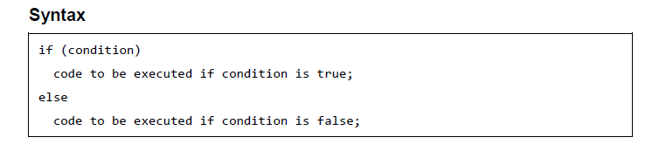
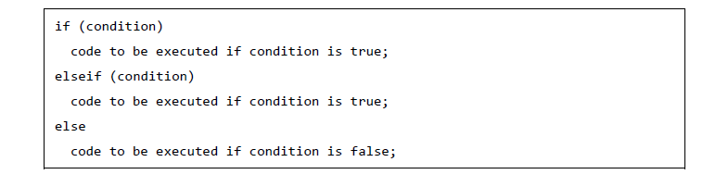
PHP ─ Decision Making
The If...Else Statement
The ElseIf Statement
Notes:
A markup language is a set of tags and/or a set of rules for creating tags that can be embedded in digital text to provide additional information about the text in order to facilitate automated processing of it, including editing and formatting for display or printing.Dec 13, 2006
The browsers we will talk about
There are five major browsers used on desktop today: Chrome, Internet Explorer, Firefox, Safari and Opera. On mobile, the main browsers are Android Browser, iPhone, Opera Mini and Opera Mobile, UC Browser, the Nokia S40/S60 browsers and Chrome–all of which, except for the Opera browsers, are based on WebKit. I will give examples from the open source browsers Firefox and Chrome, and Safari (which is partly open source). According to StatCounter statistics (as of June 2013) Chrome, Firefox and Safari make up around 71% of global desktop browser usage. On mobile, Android Browser, iPhone and Chrome constitute around 54% of usage.
The browser's main functionality
The main function of a browser is to present the web resource you choose, by requesting it from the server and displaying it in the browser window. The resource is usually an HTML document, but may also be a PDF, image, or some other type of content. The location of the resource is specified by the user using a URI (Uniform Resource Identifier).
The way the browser interprets and displays HTML files is specified in the HTML and CSS specifications. These specifications are maintained by the W3C (World Wide Web Consortium) organization, which is the standards organization for the web. For years browsers conformed to only a part of the specifications and developed their own extensions. That caused serious compatibility issues for web authors. Today most of the browsers more or less conform to the specifications.

Slide 20
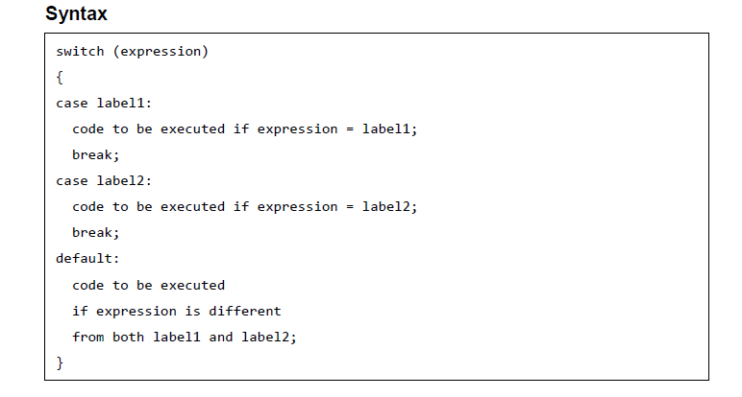
PHP ─ Decision Making
The Switch Statement
Notes:
A markup language is a set of tags and/or a set of rules for creating tags that can be embedded in digital text to provide additional information about the text in order to facilitate automated processing of it, including editing and formatting for display or printing.Dec 13, 2006
The browsers we will talk about
There are five major browsers used on desktop today: Chrome, Internet Explorer, Firefox, Safari and Opera. On mobile, the main browsers are Android Browser, iPhone, Opera Mini and Opera Mobile, UC Browser, the Nokia S40/S60 browsers and Chrome–all of which, except for the Opera browsers, are based on WebKit. I will give examples from the open source browsers Firefox and Chrome, and Safari (which is partly open source). According to StatCounter statistics (as of June 2013) Chrome, Firefox and Safari make up around 71% of global desktop browser usage. On mobile, Android Browser, iPhone and Chrome constitute around 54% of usage.
The browser's main functionality
The main function of a browser is to present the web resource you choose, by requesting it from the server and displaying it in the browser window. The resource is usually an HTML document, but may also be a PDF, image, or some other type of content. The location of the resource is specified by the user using a URI (Uniform Resource Identifier).
The way the browser interprets and displays HTML files is specified in the HTML and CSS specifications. These specifications are maintained by the W3C (World Wide Web Consortium) organization, which is the standards organization for the web. For years browsers conformed to only a part of the specifications and developed their own extensions. That caused serious compatibility issues for web authors. Today most of the browsers more or less conform to the specifications.

Slide 21
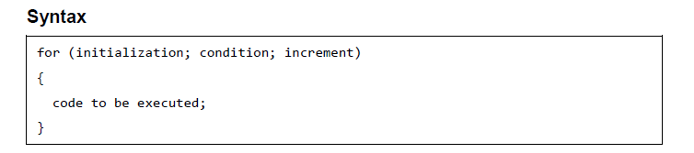
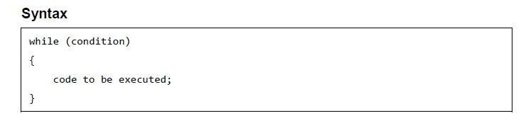
PHP ─ Loop Types
The for loop statement
The while loop statement
Notes:
A markup language is a set of tags and/or a set of rules for creating tags that can be embedded in digital text to provide additional information about the text in order to facilitate automated processing of it, including editing and formatting for display or printing.Dec 13, 2006
The browsers we will talk about
There are five major browsers used on desktop today: Chrome, Internet Explorer, Firefox, Safari and Opera. On mobile, the main browsers are Android Browser, iPhone, Opera Mini and Opera Mobile, UC Browser, the Nokia S40/S60 browsers and Chrome–all of which, except for the Opera browsers, are based on WebKit. I will give examples from the open source browsers Firefox and Chrome, and Safari (which is partly open source). According to StatCounter statistics (as of June 2013) Chrome, Firefox and Safari make up around 71% of global desktop browser usage. On mobile, Android Browser, iPhone and Chrome constitute around 54% of usage.
The browser's main functionality
The main function of a browser is to present the web resource you choose, by requesting it from the server and displaying it in the browser window. The resource is usually an HTML document, but may also be a PDF, image, or some other type of content. The location of the resource is specified by the user using a URI (Uniform Resource Identifier).
The way the browser interprets and displays HTML files is specified in the HTML and CSS specifications. These specifications are maintained by the W3C (World Wide Web Consortium) organization, which is the standards organization for the web. For years browsers conformed to only a part of the specifications and developed their own extensions. That caused serious compatibility issues for web authors. Today most of the browsers more or less conform to the specifications.

Slide 22
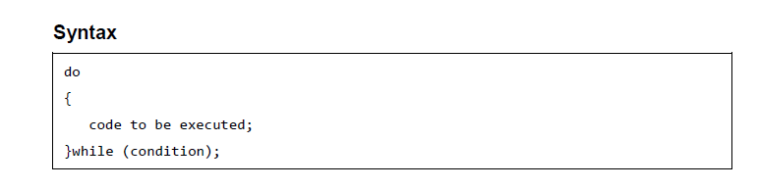
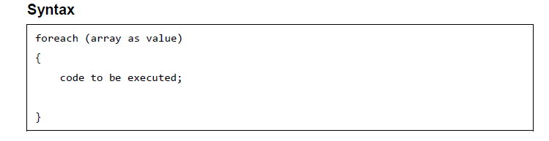
PHP ─ Loop Types
The do...while loop statement
The foreach loop statement
Notes:
A markup language is a set of tags and/or a set of rules for creating tags that can be embedded in digital text to provide additional information about the text in order to facilitate automated processing of it, including editing and formatting for display or printing.Dec 13, 2006
The browsers we will talk about
There are five major browsers used on desktop today: Chrome, Internet Explorer, Firefox, Safari and Opera. On mobile, the main browsers are Android Browser, iPhone, Opera Mini and Opera Mobile, UC Browser, the Nokia S40/S60 browsers and Chrome–all of which, except for the Opera browsers, are based on WebKit. I will give examples from the open source browsers Firefox and Chrome, and Safari (which is partly open source). According to StatCounter statistics (as of June 2013) Chrome, Firefox and Safari make up around 71% of global desktop browser usage. On mobile, Android Browser, iPhone and Chrome constitute around 54% of usage.
The browser's main functionality
The main function of a browser is to present the web resource you choose, by requesting it from the server and displaying it in the browser window. The resource is usually an HTML document, but may also be a PDF, image, or some other type of content. The location of the resource is specified by the user using a URI (Uniform Resource Identifier).
The way the browser interprets and displays HTML files is specified in the HTML and CSS specifications. These specifications are maintained by the W3C (World Wide Web Consortium) organization, which is the standards organization for the web. For years browsers conformed to only a part of the specifications and developed their own extensions. That caused serious compatibility issues for web authors. Today most of the browsers more or less conform to the specifications.

Slide 23
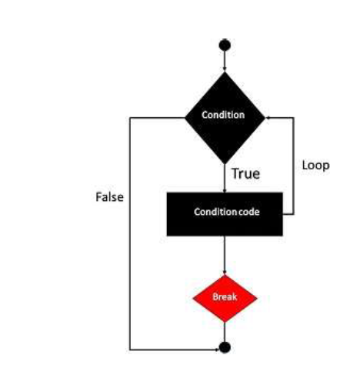
PHP ─ Loop Types
The break statement
Notes:
A markup language is a set of tags and/or a set of rules for creating tags that can be embedded in digital text to provide additional information about the text in order to facilitate automated processing of it, including editing and formatting for display or printing.Dec 13, 2006
The browsers we will talk about
There are five major browsers used on desktop today: Chrome, Internet Explorer, Firefox, Safari and Opera. On mobile, the main browsers are Android Browser, iPhone, Opera Mini and Opera Mobile, UC Browser, the Nokia S40/S60 browsers and Chrome–all of which, except for the Opera browsers, are based on WebKit. I will give examples from the open source browsers Firefox and Chrome, and Safari (which is partly open source). According to StatCounter statistics (as of June 2013) Chrome, Firefox and Safari make up around 71% of global desktop browser usage. On mobile, Android Browser, iPhone and Chrome constitute around 54% of usage.
The browser's main functionality
The main function of a browser is to present the web resource you choose, by requesting it from the server and displaying it in the browser window. The resource is usually an HTML document, but may also be a PDF, image, or some other type of content. The location of the resource is specified by the user using a URI (Uniform Resource Identifier).
The way the browser interprets and displays HTML files is specified in the HTML and CSS specifications. These specifications are maintained by the W3C (World Wide Web Consortium) organization, which is the standards organization for the web. For years browsers conformed to only a part of the specifications and developed their own extensions. That caused serious compatibility issues for web authors. Today most of the browsers more or less conform to the specifications.

Slide 24
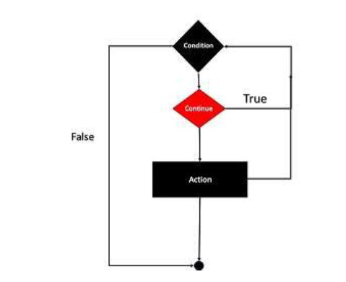
PHP ─ Loop Types
The continue statement
Notes:
A markup language is a set of tags and/or a set of rules for creating tags that can be embedded in digital text to provide additional information about the text in order to facilitate automated processing of it, including editing and formatting for display or printing.Dec 13, 2006
The browsers we will talk about
There are five major browsers used on desktop today: Chrome, Internet Explorer, Firefox, Safari and Opera. On mobile, the main browsers are Android Browser, iPhone, Opera Mini and Opera Mobile, UC Browser, the Nokia S40/S60 browsers and Chrome–all of which, except for the Opera browsers, are based on WebKit. I will give examples from the open source browsers Firefox and Chrome, and Safari (which is partly open source). According to StatCounter statistics (as of June 2013) Chrome, Firefox and Safari make up around 71% of global desktop browser usage. On mobile, Android Browser, iPhone and Chrome constitute around 54% of usage.
The browser's main functionality
The main function of a browser is to present the web resource you choose, by requesting it from the server and displaying it in the browser window. The resource is usually an HTML document, but may also be a PDF, image, or some other type of content. The location of the resource is specified by the user using a URI (Uniform Resource Identifier).
The way the browser interprets and displays HTML files is specified in the HTML and CSS specifications. These specifications are maintained by the W3C (World Wide Web Consortium) organization, which is the standards organization for the web. For years browsers conformed to only a part of the specifications and developed their own extensions. That caused serious compatibility issues for web authors. Today most of the browsers more or less conform to the specifications.

Slide 25
PHP ─ Arrays
There are three different kind of arrays and each array value is accessed using an ID which is called array index.
• Numeric array - An array with a numeric index. Values are stored and accessed in linear fashion
• Associative array - An array with strings as index. This stores element values in association with key values rather than in a strict linear index order.
• Multidimensional array - An array containing one or more arrays and values are
accessed using multiple indices
Notes:
A markup language is a set of tags and/or a set of rules for creating tags that can be embedded in digital text to provide additional information about the text in order to facilitate automated processing of it, including editing and formatting for display or printing.Dec 13, 2006
The browsers we will talk about
There are five major browsers used on desktop today: Chrome, Internet Explorer, Firefox, Safari and Opera. On mobile, the main browsers are Android Browser, iPhone, Opera Mini and Opera Mobile, UC Browser, the Nokia S40/S60 browsers and Chrome–all of which, except for the Opera browsers, are based on WebKit. I will give examples from the open source browsers Firefox and Chrome, and Safari (which is partly open source). According to StatCounter statistics (as of June 2013) Chrome, Firefox and Safari make up around 71% of global desktop browser usage. On mobile, Android Browser, iPhone and Chrome constitute around 54% of usage.
The browser's main functionality
The main function of a browser is to present the web resource you choose, by requesting it from the server and displaying it in the browser window. The resource is usually an HTML document, but may also be a PDF, image, or some other type of content. The location of the resource is specified by the user using a URI (Uniform Resource Identifier).
The way the browser interprets and displays HTML files is specified in the HTML and CSS specifications. These specifications are maintained by the W3C (World Wide Web Consortium) organization, which is the standards organization for the web. For years browsers conformed to only a part of the specifications and developed their own extensions. That caused serious compatibility issues for web authors. Today most of the browsers more or less conform to the specifications.

Slide 26

PHP ─ Arrays
Numeric Array
Notes:
A markup language is a set of tags and/or a set of rules for creating tags that can be embedded in digital text to provide additional information about the text in order to facilitate automated processing of it, including editing and formatting for display or printing.Dec 13, 2006
The browsers we will talk about
There are five major browsers used on desktop today: Chrome, Internet Explorer, Firefox, Safari and Opera. On mobile, the main browsers are Android Browser, iPhone, Opera Mini and Opera Mobile, UC Browser, the Nokia S40/S60 browsers and Chrome–all of which, except for the Opera browsers, are based on WebKit. I will give examples from the open source browsers Firefox and Chrome, and Safari (which is partly open source). According to StatCounter statistics (as of June 2013) Chrome, Firefox and Safari make up around 71% of global desktop browser usage. On mobile, Android Browser, iPhone and Chrome constitute around 54% of usage.
The browser's main functionality
The main function of a browser is to present the web resource you choose, by requesting it from the server and displaying it in the browser window. The resource is usually an HTML document, but may also be a PDF, image, or some other type of content. The location of the resource is specified by the user using a URI (Uniform Resource Identifier).
The way the browser interprets and displays HTML files is specified in the HTML and CSS specifications. These specifications are maintained by the W3C (World Wide Web Consortium) organization, which is the standards organization for the web. For years browsers conformed to only a part of the specifications and developed their own extensions. That caused serious compatibility issues for web authors. Today most of the browsers more or less conform to the specifications.

Slide 27
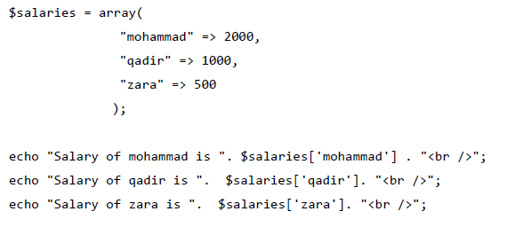
PHP ─ Arrays
Associative Arrays
Notes:
A markup language is a set of tags and/or a set of rules for creating tags that can be embedded in digital text to provide additional information about the text in order to facilitate automated processing of it, including editing and formatting for display or printing.Dec 13, 2006
The browsers we will talk about
There are five major browsers used on desktop today: Chrome, Internet Explorer, Firefox, Safari and Opera. On mobile, the main browsers are Android Browser, iPhone, Opera Mini and Opera Mobile, UC Browser, the Nokia S40/S60 browsers and Chrome–all of which, except for the Opera browsers, are based on WebKit. I will give examples from the open source browsers Firefox and Chrome, and Safari (which is partly open source). According to StatCounter statistics (as of June 2013) Chrome, Firefox and Safari make up around 71% of global desktop browser usage. On mobile, Android Browser, iPhone and Chrome constitute around 54% of usage.
The browser's main functionality
The main function of a browser is to present the web resource you choose, by requesting it from the server and displaying it in the browser window. The resource is usually an HTML document, but may also be a PDF, image, or some other type of content. The location of the resource is specified by the user using a URI (Uniform Resource Identifier).
The way the browser interprets and displays HTML files is specified in the HTML and CSS specifications. These specifications are maintained by the W3C (World Wide Web Consortium) organization, which is the standards organization for the web. For years browsers conformed to only a part of the specifications and developed their own extensions. That caused serious compatibility issues for web authors. Today most of the browsers more or less conform to the specifications.

Slide 28
PHP ─ Arrays
Multidimensional Arrays
$marks = array(
"mohammad" => array
(
"physics" => 35,
"maths" => 30,
"chemistry" => 39
),
"qadir" => array
(
"physics" => 30,
"maths" => 32,
"chemistry" => 29
),
"zara" => array
(
"physics" => 31,
"maths" => 22,
"chemistry" => 39
)
);
/* Accessing multi-dimensional array values */
echo "Marks for mohammad in physics : " ;
echo $marks['mohammad']['physics'] . "<br />";
Notes:
A markup language is a set of tags and/or a set of rules for creating tags that can be embedded in digital text to provide additional information about the text in order to facilitate automated processing of it, including editing and formatting for display or printing.Dec 13, 2006
The browsers we will talk about
There are five major browsers used on desktop today: Chrome, Internet Explorer, Firefox, Safari and Opera. On mobile, the main browsers are Android Browser, iPhone, Opera Mini and Opera Mobile, UC Browser, the Nokia S40/S60 browsers and Chrome–all of which, except for the Opera browsers, are based on WebKit. I will give examples from the open source browsers Firefox and Chrome, and Safari (which is partly open source). According to StatCounter statistics (as of June 2013) Chrome, Firefox and Safari make up around 71% of global desktop browser usage. On mobile, Android Browser, iPhone and Chrome constitute around 54% of usage.
The browser's main functionality
The main function of a browser is to present the web resource you choose, by requesting it from the server and displaying it in the browser window. The resource is usually an HTML document, but may also be a PDF, image, or some other type of content. The location of the resource is specified by the user using a URI (Uniform Resource Identifier).
The way the browser interprets and displays HTML files is specified in the HTML and CSS specifications. These specifications are maintained by the W3C (World Wide Web Consortium) organization, which is the standards organization for the web. For years browsers conformed to only a part of the specifications and developed their own extensions. That caused serious compatibility issues for web authors. Today most of the browsers more or less conform to the specifications.

Slide 29
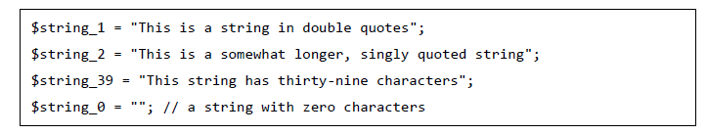
PHP ─ Strings
The escape-sequence replacements are:
• \n is replaced by the newline character
• \r is replaced by the carriage-return character
\t is replaced by the tab character
\$ is replaced by the dollar sign itself ($)
• \" is replaced by a single double-quote (")
• \\ is replaced by a single backslash (\)
Notes:
A markup language is a set of tags and/or a set of rules for creating tags that can be embedded in digital text to provide additional information about the text in order to facilitate automated processing of it, including editing and formatting for display or printing.Dec 13, 2006
The browsers we will talk about
There are five major browsers used on desktop today: Chrome, Internet Explorer, Firefox, Safari and Opera. On mobile, the main browsers are Android Browser, iPhone, Opera Mini and Opera Mobile, UC Browser, the Nokia S40/S60 browsers and Chrome–all of which, except for the Opera browsers, are based on WebKit. I will give examples from the open source browsers Firefox and Chrome, and Safari (which is partly open source). According to StatCounter statistics (as of June 2013) Chrome, Firefox and Safari make up around 71% of global desktop browser usage. On mobile, Android Browser, iPhone and Chrome constitute around 54% of usage.
The browser's main functionality
The main function of a browser is to present the web resource you choose, by requesting it from the server and displaying it in the browser window. The resource is usually an HTML document, but may also be a PDF, image, or some other type of content. The location of the resource is specified by the user using a URI (Uniform Resource Identifier).
The way the browser interprets and displays HTML files is specified in the HTML and CSS specifications. These specifications are maintained by the W3C (World Wide Web Consortium) organization, which is the standards organization for the web. For years browsers conformed to only a part of the specifications and developed their own extensions. That caused serious compatibility issues for web authors. Today most of the browsers more or less conform to the specifications.

Slide 30
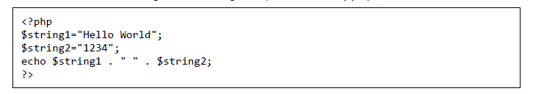


PHP ─ Strings
String Concatenation Operator
Using the strlen() function
Using the strpos() function
Notes:
A markup language is a set of tags and/or a set of rules for creating tags that can be embedded in digital text to provide additional information about the text in order to facilitate automated processing of it, including editing and formatting for display or printing.Dec 13, 2006
The browsers we will talk about
There are five major browsers used on desktop today: Chrome, Internet Explorer, Firefox, Safari and Opera. On mobile, the main browsers are Android Browser, iPhone, Opera Mini and Opera Mobile, UC Browser, the Nokia S40/S60 browsers and Chrome–all of which, except for the Opera browsers, are based on WebKit. I will give examples from the open source browsers Firefox and Chrome, and Safari (which is partly open source). According to StatCounter statistics (as of June 2013) Chrome, Firefox and Safari make up around 71% of global desktop browser usage. On mobile, Android Browser, iPhone and Chrome constitute around 54% of usage.
The browser's main functionality
The main function of a browser is to present the web resource you choose, by requesting it from the server and displaying it in the browser window. The resource is usually an HTML document, but may also be a PDF, image, or some other type of content. The location of the resource is specified by the user using a URI (Uniform Resource Identifier).
The way the browser interprets and displays HTML files is specified in the HTML and CSS specifications. These specifications are maintained by the W3C (World Wide Web Consortium) organization, which is the standards organization for the web. For years browsers conformed to only a part of the specifications and developed their own extensions. That caused serious compatibility issues for web authors. Today most of the browsers more or less conform to the specifications.

Slide 31

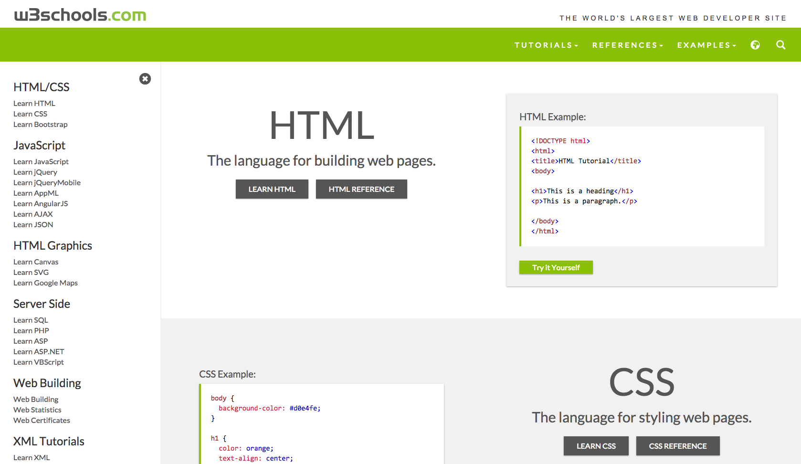
References...

